Slide 1

Beacon Chain
Introduction on State Object

Slide 2
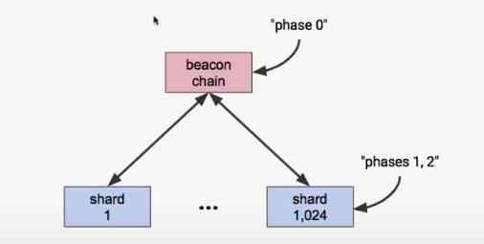
HUB AND SPOKE MODEL

Slide 3
Beacon Chain
Works more like a Voting Machine
It is the place where we Organize the Voters (Validators) and Process the votes called attestations
Rewards and Penalties are applied at this layer
It does not have any user Transaction

Slide 4
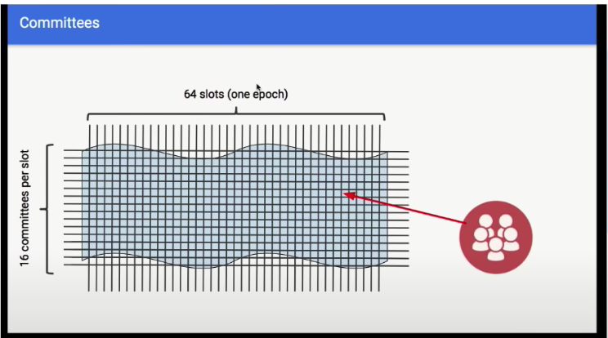
Basics about beacon chain
Slots are Discrete time for 12 sec each
Each Slot can generate one Block
One Block Proposer is elected for a slot, It is possible that there is not block produced in any slot
32 Slots - 1 epoch
32 committees per slot
32 * 32 = 1024 committees
One committee per Shard - One Committee is assigned a task
Each Single validator will get one vote per Epoch
Is that mean one committee has more than one validator and one of them will be selected for block production in that slot?

Slide 5
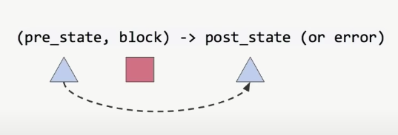
State transition
Most part of the spec talks about state transition
State transition invloves with state object and block object

Slide 6
BASIC TYPES of Component to build Object
Uint64 (8 bytes) - Serialization 8 bytes (little endian) Ex :- Slot, Epoch (64 slots), Shard, Index (validator index), Amount, Timestamp
Byte - Ex:- Hash, State roots (32 bytes), Pub Key (48 bytes), Signatures (96 bytes), Bitfield
Bool - Flag

Slide 7
Composite type
Containers - Heterogeneous Object
{
slot Slot (8 bytes) ,
prev_b_root Root (32 bytes),
state_root Root,
block_body_root Root,
signature Signature (96 bytes),
}
Tuples - fixed array. [uint64, uint64, uint64, uint64, uint64]]
Lists - variable array [uint64, uint64, uint64 …...]

Slide 8
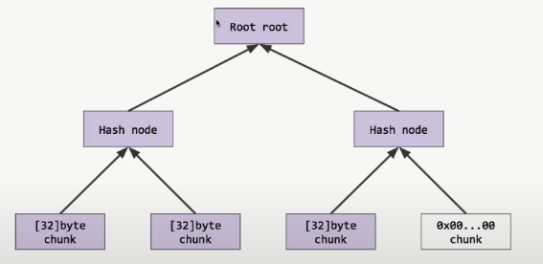
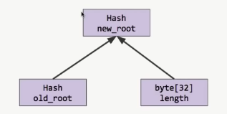
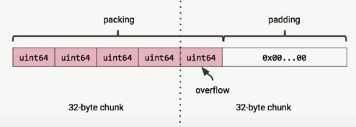
Object Marketisation
Simple Serialized Spec for Client communication
Basic Objects, basic tuples - Pack them into 32 byte Chunks and Merkleize
basic list - Pack them into 32 byte Chunks and Merkleize, Mix the Length
containers, composite tuples - Recursive Merkleize, Merkleize root

Slide 9
State Object

Slide 10
Versioning
genesis_time type uint64 : Burner contract acts as bridge between Eth1 and Beacon chain, receipts of deposit receives by this contract is consumed by Eth2 chain and once we have enough of these receipts then the staking process could be started. So the Genesis can be initiated after 24 hours of receiving 2 million ether deposit receipts (Just to make sure to have enough confirmation & a clean genesis start )
slot type Slot (uint64) : duration of slot is 6 sec but could vary from 5 to 7 due to leap second in Unix time, Epoch = slots / 64
fork type Fork
{
prev_version uint64, ﻿ ﻿
﻿current_version uint64,
epoch Epoch(uint64)
} : This field of to provide a native support for hard forking

Slide 11
Root
latest_block_roots type [8192] Root (32 bytes ) : This is expose to shards, calculated whenever a block is generated
latest_state_root type [8192] Root : calculated at every slot [8192] Root
historical_roots type [] Root : Merkleise block root and stateroot for last Every 8000 slots, so a new value is added only after 8k slots, with this we can prove that some block root or state root was a given value in the past?
latest_block_header type BlockHeader
{
slot Slot (8 bytes) ,
Prev_b_root Root (32 bytes),
State_root Root,
Block_body_root Root,
Sig Signature (96 bytes),
}

Slide 12
ETH1
Eth1 chain is used to bootstrap Eth2 chain and eth2 chain contain data about Eth1 chain in this section.
latest_eth1_data Eth1Data
{ deposit_root type Root : Merkle root of all the deposits up to the point in the deposit contract
block_hash type Root } : Recent Block hash in Eth1 Chain
Eth1_data_votes []Eth1DataVote { eth1_data type Eth1Data, vote_count type Unit64 }
When ever a new Eth1 data wants to persist on Eth2 chain, Eth2 selects a committe from block proposer and when more than 50% vote for Eth1 data then it is accepted.

Slide 13
Registry
Validator_registry type []Validator
{
pubkey type PubKey,
withdrawal_credentials type Root,
Every validator will have two pubkey, one which is his day to day siging key and another is for used for withdraw money from the system, withdrawal_credentials is the
has of that key.these two fields are specified in the deposit transaction which we do at Eth1 to become a validator.
activation_epoch type Epoch, : Once deposit is >= 32 eth, validator is activated and activation should be >= Current epoch
exit_epoch type Epoch,
There are ways of Exit a) if your balance is significantly lower b) if you attests wrong blocks (Forced exit) c) voluntary exit, you can raise a voluntary exit message, This field also helps
to check the active validators in the system, if you check active validator for a epoch the scan the whole registry and get the validators for whom correct epoch falls in
between activation epoch and exit epoch.
withdrawal_epoch type Epoch,
voluntary_exit flag, : This flag is to make the exit validator push into exit queue and make sure that there should be a constant number of validator in system
slashed flag,
}}

Slide 14
Registry
validator_balances type []Amount
This field is intentionally kept out from validator structure as if you observe all of validator fields will not going to change in their life span But validator balance will keep changing every epoch due to micro payment/slashing, so it avoid hashing overhead
validator_reg_update_epoch type Epoch
latest_active_index_root type [8192] Root
This fields is mostly used for light client operation, in a certain time period system make a checkpoint for the active validator by voting process (voted by the last checkpoint active validators) and save the root of the result in this field, these checkpoint is useful for light clients

Slide 15
Shuffling
This section is imp to maintain high level of security for beacon chain by shuffling the validator sets,
It takes the validators + Seed (RanDOA Mix) Passed into Shuffle Function and spit Shuffled Validators
This Shuffle Function should have two basic properties
It should provide Pseudo random permutation - This means every validator should assigned to one unique place
Locally computable - It we take a specific validator, and want to compute where it has been assigned to, without having to compute the permutation on the whole validator set.
Suffling function
Seed which is a random number on validator index line
Build the pairs around that pivot
Seed random bit for each pair (either 0 or 1). take the position of the bit and hash it with seed rB = Hash(Bindex + Seed)
If the Seed bit is 1 then you swap the pair
Repeat this process 90 times
After getting the shuffled validators we can create the 1024 committee from this set which will be assigned to 1024 shards

Slide 16
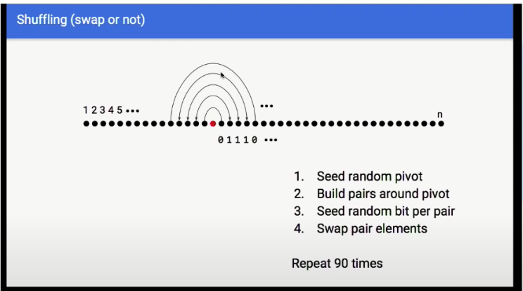
Shuffling function example - ( swap or not )
64 Slots - 1 epoch
16 committees per slot
64 * 16 = 1024 committees
One committee per Shard - One Committee is assigned a task
Each Single validator will get one vote per Epoch

Slide 17
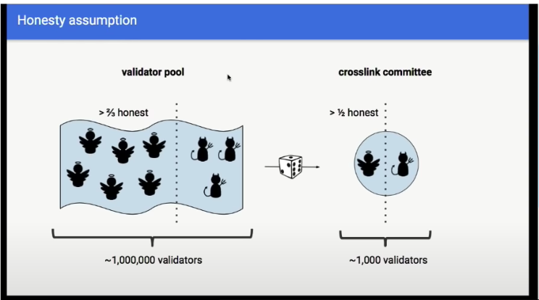
Honesty Assumption
2/3 of the validator are honest?
After shuffling function atleast ½ of the selected validator are honest?
I don’t understand how we have made the 1st and 2nd assumption

Slide 18
Shuffling
latest_randao_mixes [8192]Bytes32
Below fields are used to recompute the set of active validators relative to two different shuffling from the recent past
previous_shuffling_seed Bytes32
previous_shuffling_epoch Epoch
previous_shuffling_start_shard Shard
current_shuffling_seed Bytes32
current_shuffling_epoch Epoch
current_shuffling_start_shard Shard

Slide 19
Finality
This section gives us notion of economic finality .i.e. if something goes wrong like we have two cross-links (cross voting on two different block on same height) or we can say two finilized checkpoint which are not in same fork then we have a grarantee that atleast 1/3 of active validators money will be burned
Finality is done using attestations
Here we have imp role of BLS signature which can aggregatre multiple signature done by the validator who voted for same block and end result will be a single aggregated signature which can be validated as a whole. It is one of the imp notion in scalability.

Slide 20
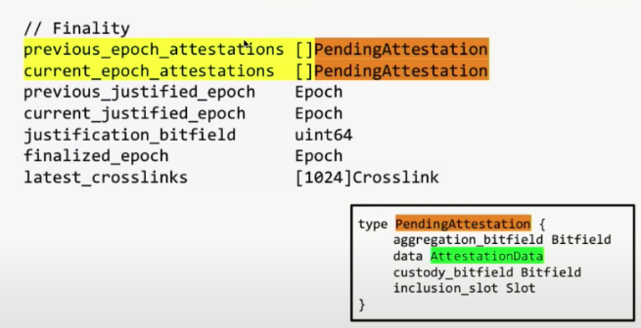
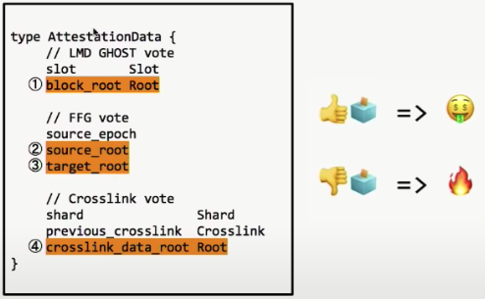
finality
There are 3 kind of attstation (Sub Vote) a Validator does during the attestation process
The 1st one is for the single block root in the beacon chain, this is imp for the Fork choice rule, which assigns the weight to every single block
FFG Vote is used for finality
CrossLink votes are used for Sharding, crosslinks are the communcation machanism between the shard, Beacon chain is aware of every shard as a light Client, CrossLink are used a shard checkpoint that get included into the beacon chain
To become a crosslink, you need to have the committee assigned to a shard agree on the cross linked data root

Slide 21
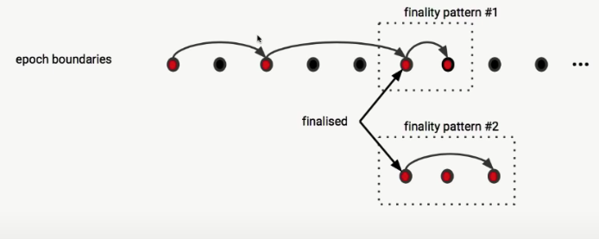
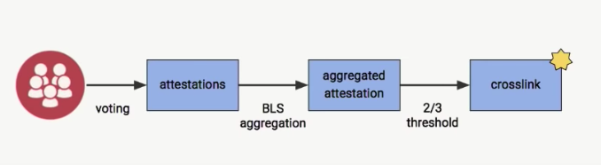
Finality – CrossLinks
Every shard is assigned to a small committee relative to total validator pool, they make the individual attestations
These attestations are aggregated using BLS aggregation (If same)
If we reach 2/3 threshold then it becomes a crosslink

Slide 22
Partial slashing
// Partial slashing
latest_slashed_balances [8192] Amount
This field keeps track of how many slahing events has been happened so that slashing can be done proportional

Slide 23
Block object

